Slide 1

Brand Forge – AI Branding Platform
Mini Project Presentation
Submitted By:-
BATCH NO:-12
1.G .Anand (235U1A0566)
2. K. Ramya(235U1A0593)
3.K. Pavithra(235U1A0594)
4.K. Kethan Harsha(235U1A0597)
Internal Guide
Mrs. B. Sushmitha
Assistant Professor

Slide 2

ABSTRACT
Brand Forge is an AI-powered branding platform designed to simplify the process of creating a brand identity. In today’s competitive world, branding requires creativity, time, and professional skills, which can be challenging for beginners and small businesses. Our system addresses this problem by providing an all-in-one solution that generates brand names, logos, banners, and marketing content using AI models. The platform uses technologies like Fast API for backend processing and integrates AI models such as LLaMA for text generation and DALL·E for image creation.
The system is designed to be simple, fast, and cost-effective, enabling users to build a complete brand efficiently. Overall, Brand Forge helps transform ideas into strong brand identities with minimal effort.

Slide 3

CONTENTS
Introduction
Literature Survey
Problem Statement
Existing System
Proposed System
System Requirements
System Architecture
Methodologies Used
UML Diagrams
Implementation Details
Output Screenshots
Sample Code
Conclusion
References

Slide 4
Introduction
Branding is very important for any business today
A strong brand helps attract more customers
But creating a brand is not easy
It needs time, creativity, and skills
Many beginners don’t know how to start
Artificial Intelligence can automate creative tasks
So, we came up with Brand Forge

Slide 5
Literature Survey
According to Fast API documentation, modern web frameworks enable fast and efficient backend development for AI applications.
Research from Meta AI (LLaMA models) shows that large language models can generate human-like text for various applications.
IBM AI documentation highlights the importance of AI in business automation and digital transformation.
MDN Web Docs provides standards for building responsive and user-friendly frontend interfaces.

Slide 6
PROBLEM STATEMENT
Branding process is complex and time-consuming
Requires designers and marketing expertise
No single platform provides complete branding solution
Manual work leads to inconsistency in outputs
Need for an automated and efficient system

Slide 7
EXISTING SYSTEM
Branding done manually using tools like Photoshop, Canva
Separate tools required for logo, content, and design
No automation or AI integration
Time-consuming and less efficient
Requires technical and creative expertise

Slide 8
PROPOSED SYSTEM
AI-powered integrated branding platform
Generates:
  - Brand names
  - Logos
  - Content
  - Banners
Uses multiple AI models for better results
Fast, scalable, and user-friendly system
Reduces manual effort and cost

Slide 9
SYSTEM REQUIREMENTS
Hardware
Processor: Intel i5 or above
RAM: 8GB minimum
Storage: 10GB free space
Software
Python 3.x
Fast API
Browser (Chrome/Edge)
Libraries
Transformers
Torch
Groq API
Hugging Face API

Slide 10
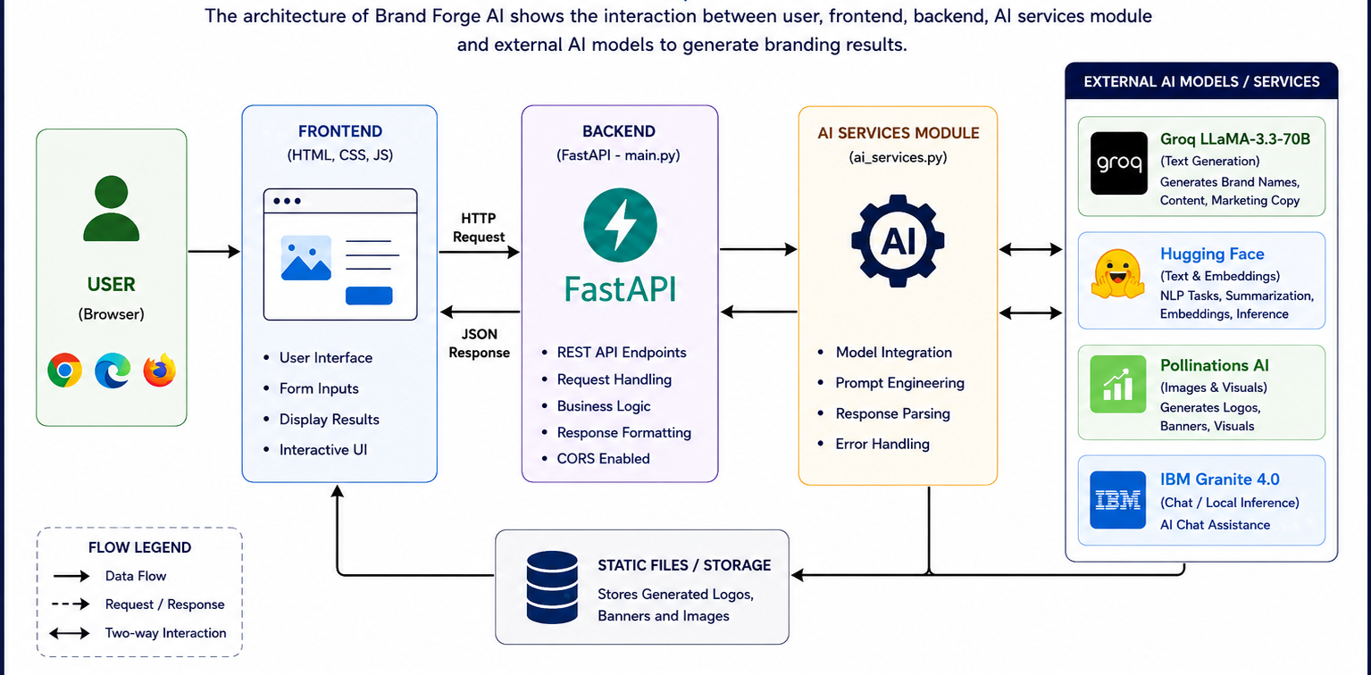
System Architecture

Slide 11
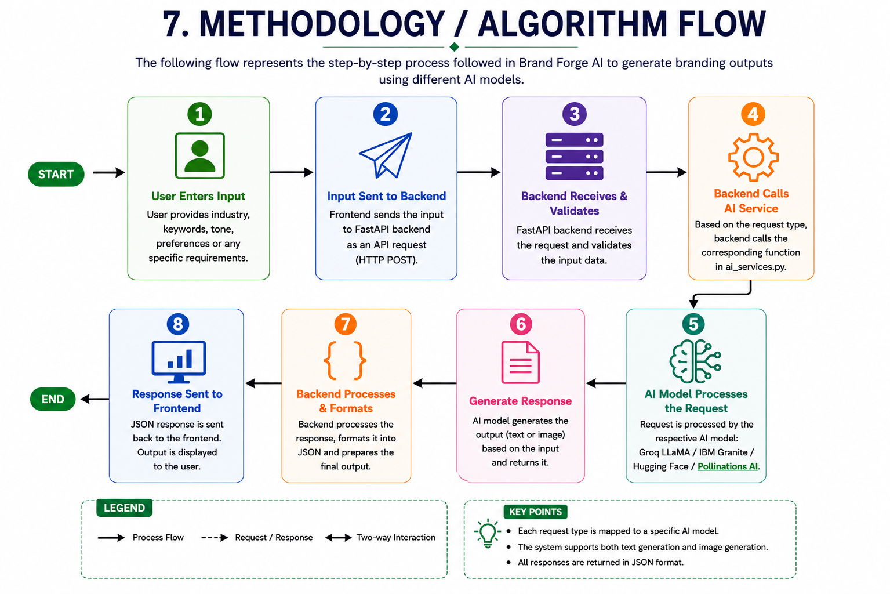
METHODOLOGY/ ALGORITHM FLOW

Slide 12
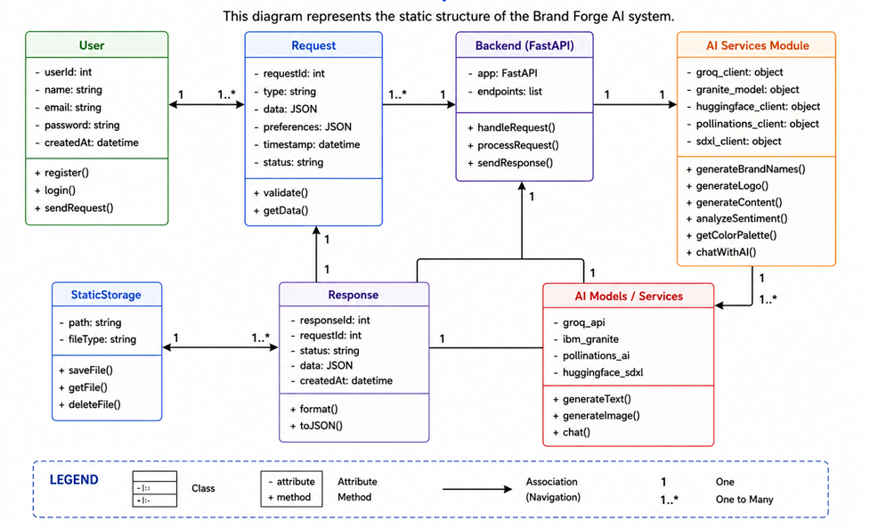
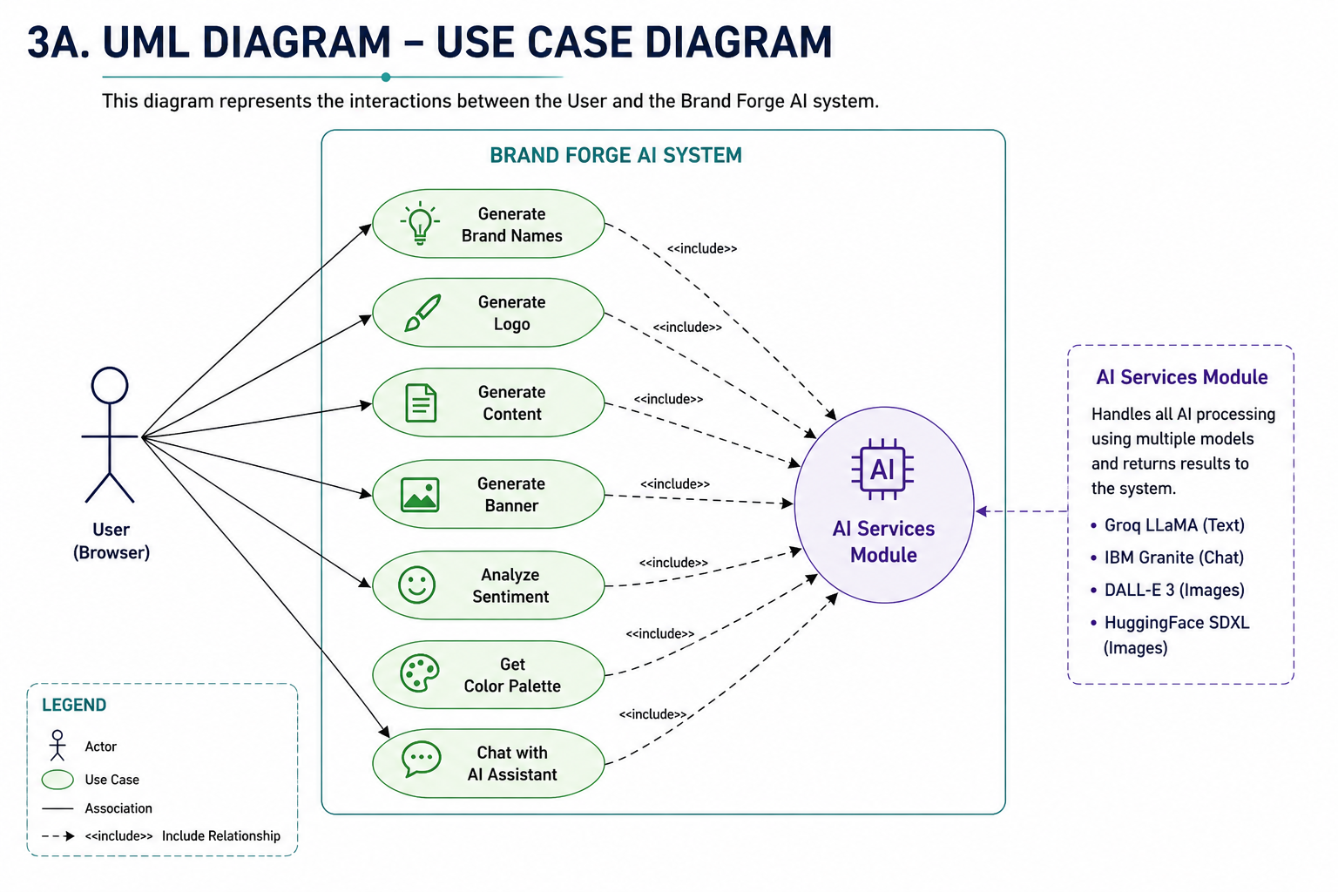
UML Diagrams – Functional View
CLASS DIAGRAM
USE CASE DIAGRAM

Slide 13
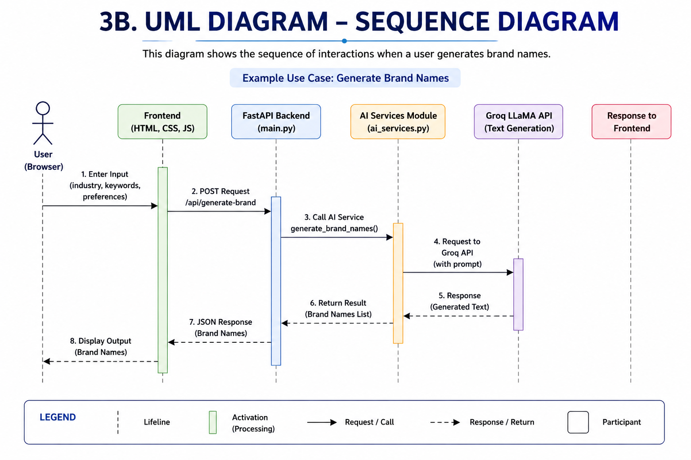
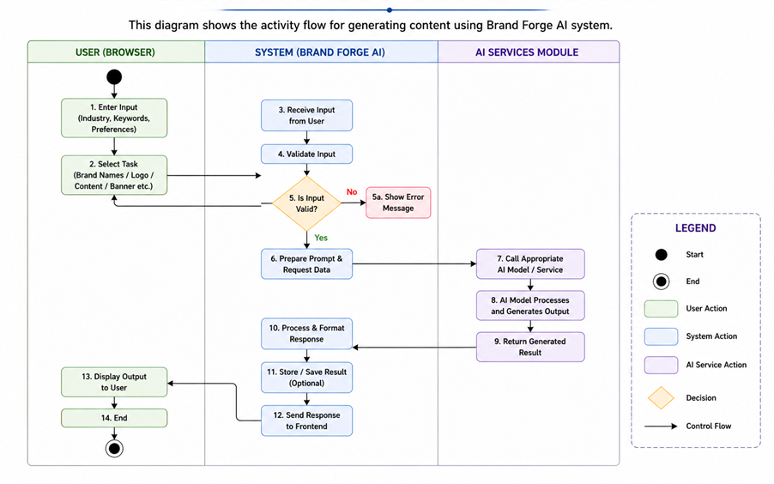
UML Diagrams – Structural & Flow View
SEQUENCE DIAGRAM
ACTIVITY DIAGRAM

Slide 14
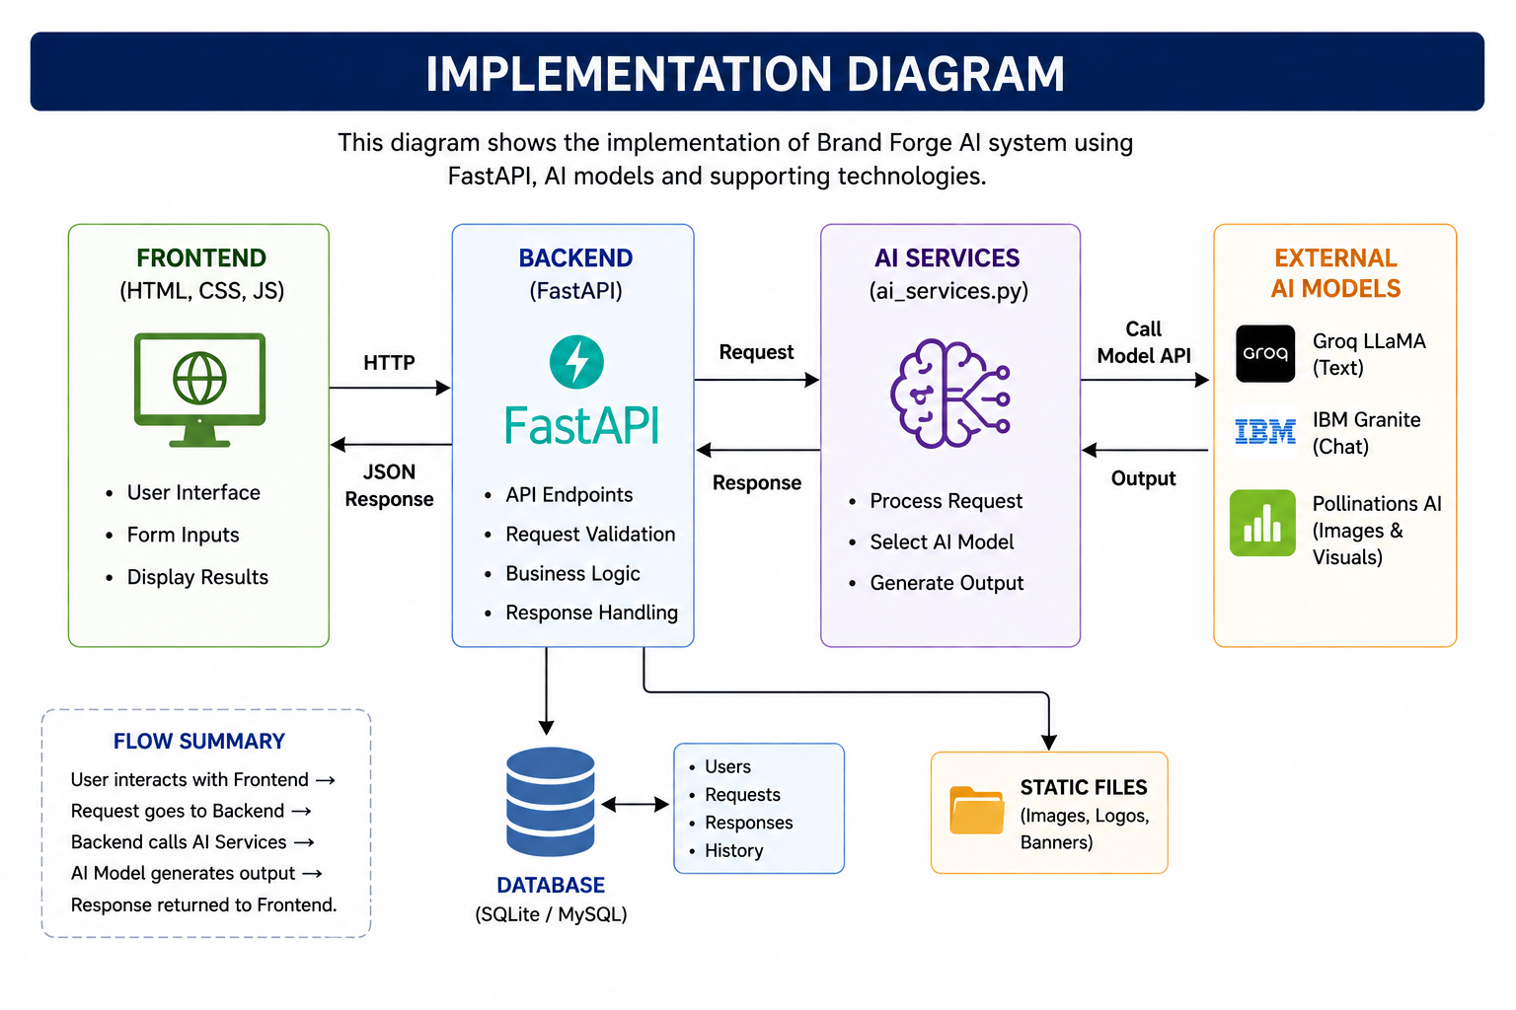
IMPLEMENTATION DETAILS

Slide 15
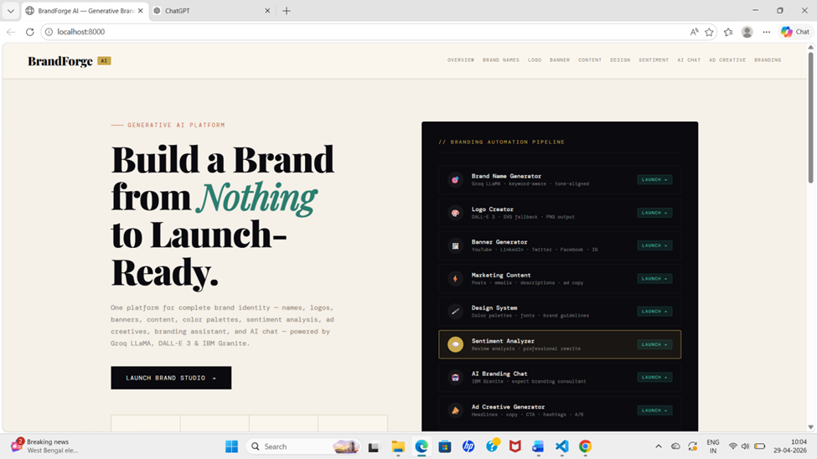
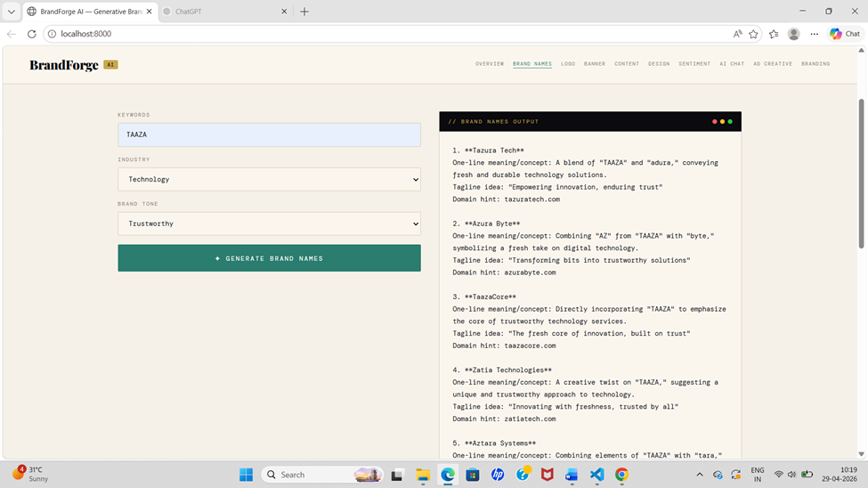
OUTPUT SCREENS

Slide 16
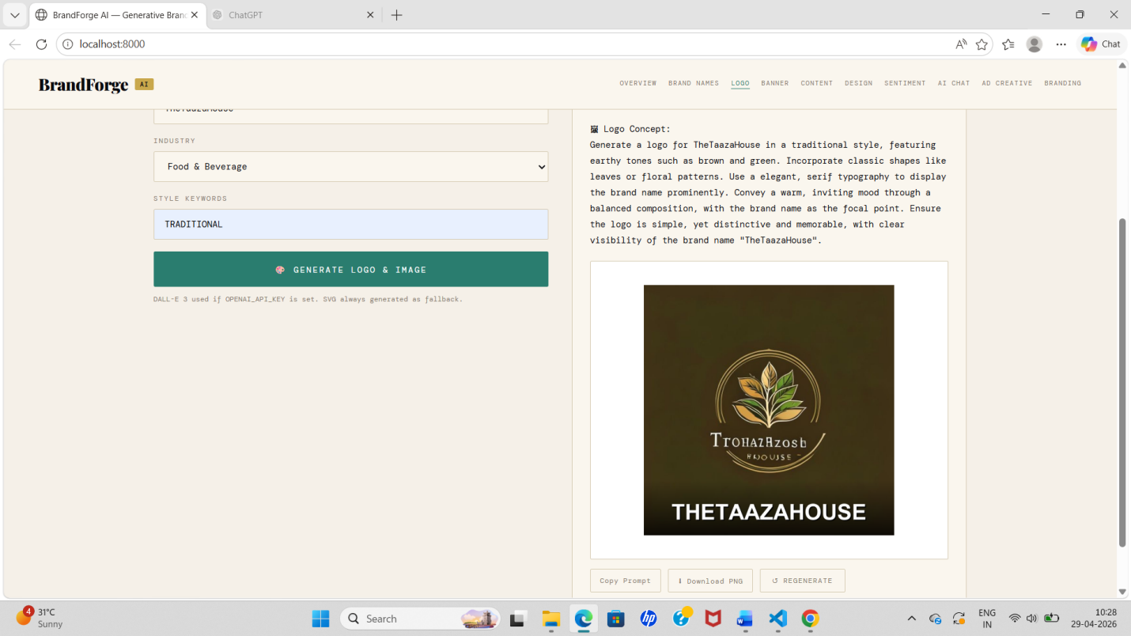
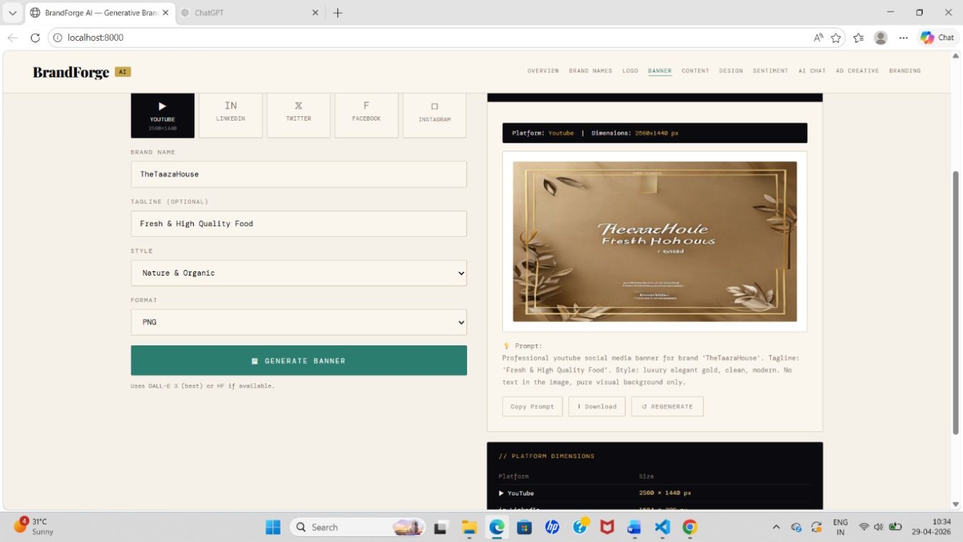

Slide 17
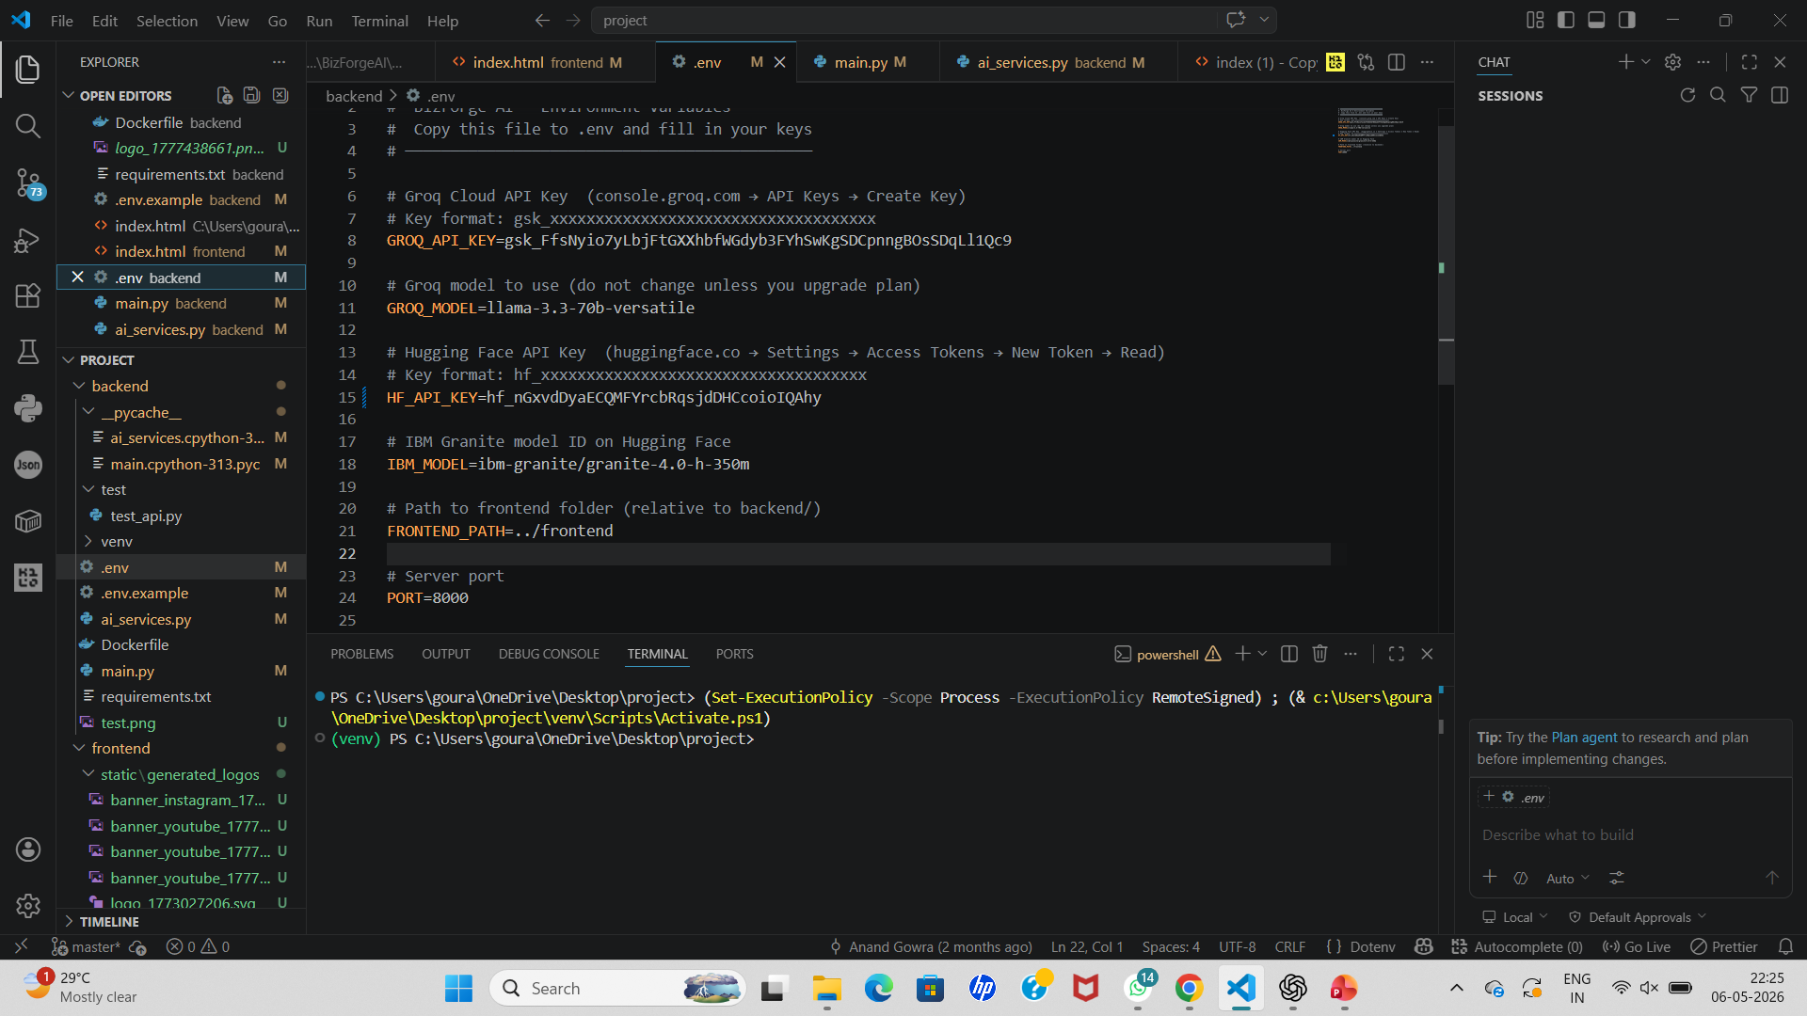
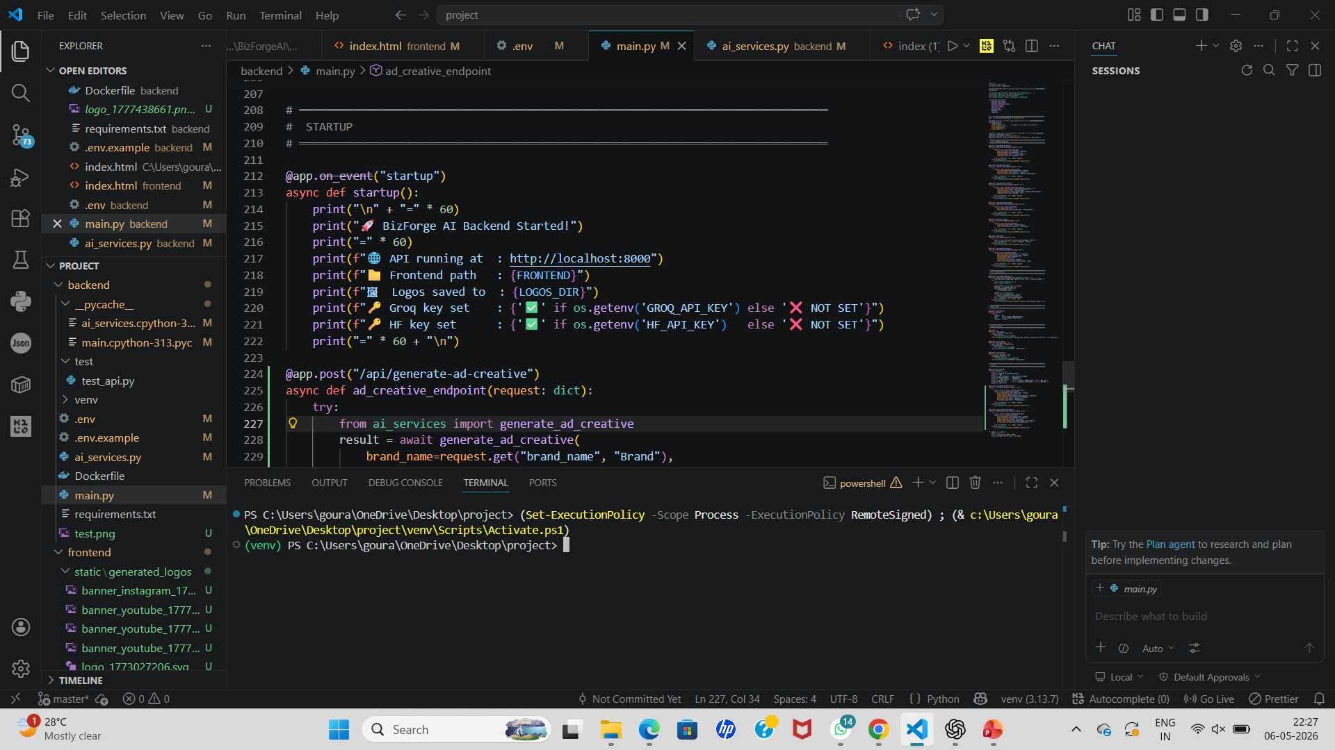
Sample Code
Brand Forge AI — Environment Variables
Brand Forge AI — Fast API Backend

Slide 18
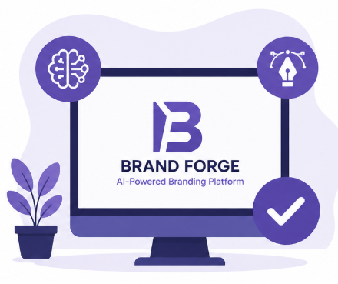
Conclusion
Brand Forge makes branding simple
Uses AI in a practical way
Useful for startups and small businesses
Saves both time and cost

Slide 19
REFERENCES
Fast API Documentation,
Available at: https://fastapi.tiangolo.com/
OpenAI Documentation (DALL·E & AI Models),
Available at: https://platform.openai.com/docs
Meta AI (LLaMA Model Documentation),
Available at: https://ai.meta.com
IBM Granite AI Documentation,
Available at: https://www.ibm.com
MDN Web Docs (HTML, CSS, JavaScript),
Available at: https://developer.mozilla.org/

Slide 20
Thank you

